Slide 2
Digital Devices SOW
KS3/ICT iGCSE (Edexcel)
16 lessons with a revision guide and an online end of unit test.
Ideal for EAL or weak ability students, focus on keywords and repetition of familiar skills.
Originally made for students at a British school in the UAE. An attempt has been made to keep definitions and concepts simple. As the lessons advance more analysis, creativity and input is steadily required from the students.

Slide 3
Lesson 1
Mainframes and Microprocessors
I can list a number of digital devices.
I will be able to describe the difference between a mainframe, server and supercomputer.

Slide 4
What will we do today?
1
2
3
4
Write down the LOs and research the three types of computer. Write the definitions in your COPY BOOK and GLOSSARY
Discuss the three key words and write them in your book. Match them to the logo.
List the microprocessors in your home.
Feedback to the teacher what you have learn today.

Slide 5
Learning Objectives:
I can list a number of digital devices.
I will be able to describe three different types of computer.
MAINFRAME COMPUTER
SERVER
SUPERCOMPUTER
Use the internet to find out what each of these computers does.
TASK: Write a paragraph on each in your copy books.
STRETCH: Can you give an example for each one – where would it be used?

Slide 6
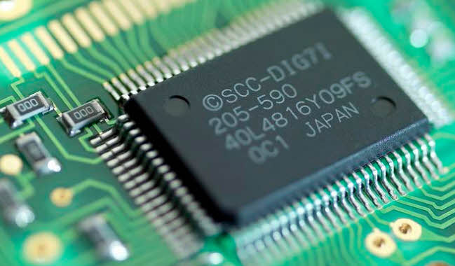
What is a microprocessor?
All computers are made up of microprocessors.
They are the ‘engines’ of the computer.
They take in data – do something with it – and output it somewhere else in the computer.

Slide 7
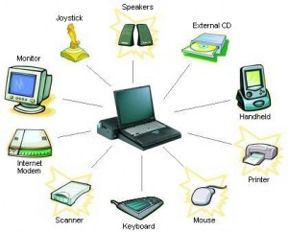
What is a peripheral device?
In English ‘peripheral’ means something on the edge or on the outside.
In computing a ‘peripheral device’ is one that is connected to the computer.

Slide 8
What is an upgrade?
In computing when you ‘upgrade’ you add something to a computer to make it better.
Or you could replace the hardware entirely with a better version.
This could be hardware or software.

Slide 9
Which icon would best go with each keyword? Add to your book.
Upgrade
Peripheral Device
Microprocessor

Slide 10
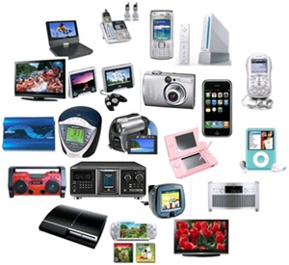
How many devices in your home use microprocessors? Make a list.
STRETCH: What other devices in the future might contain microprocessors?

Slide 11
How many devices in your home use microprocessors? Make a list.
Fridges.
DVD players.
Remote control television.
Hairdryers.
Washing machines.
Microwave cookers.
Dishwashers.
Electric kettles.
Games consoles.
STRETCH: What other devices in the future might contain microprocessors?

Slide 12
HAVE WE MET OUR LEARNING OBJECTIVES?
I can list a number of digital devices.
I will be able to describe the difference between a mainframe, server and supercomputer.
DISCUSS THE ANSWERS
WITH YOUR PARTNER
SHARE WITH THE CLASS

